Slide 1
Strategies for web-based
data dissemination
Ian M. Nunes – ian.nunes@ibge.gov.br
06/06/2013
Notes:
1

Slide 2
Simple and standardized
Layout
Standardized tables and charts
Standardized navigation experience and behavior
Thematic classification
Unified taxonomy
Notes:
2

Slide 3
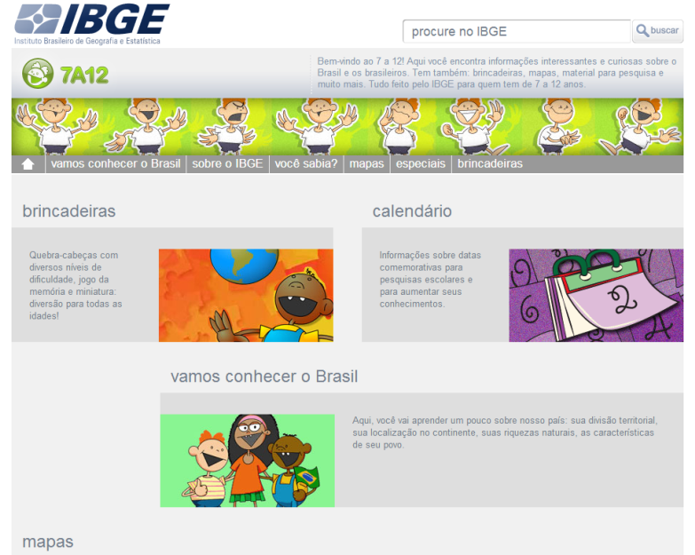
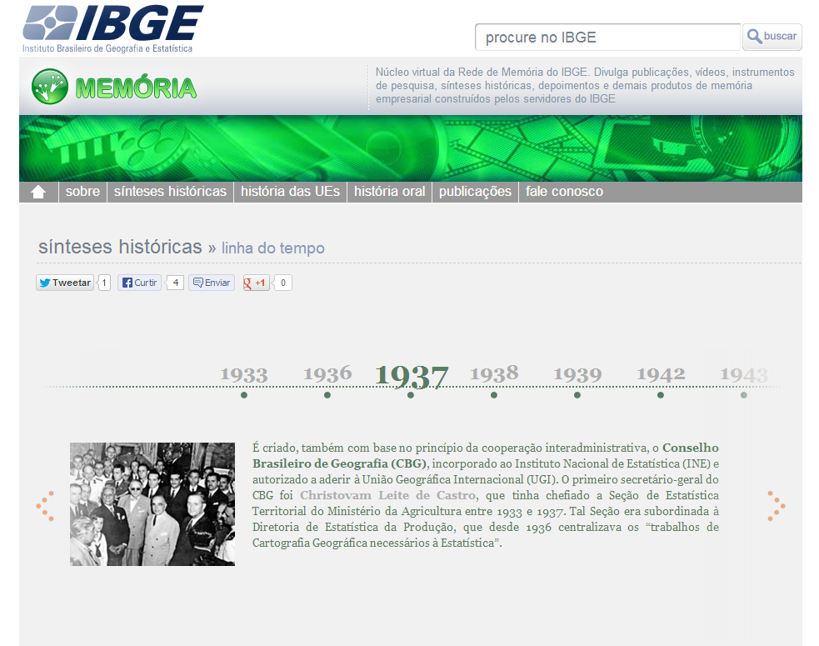
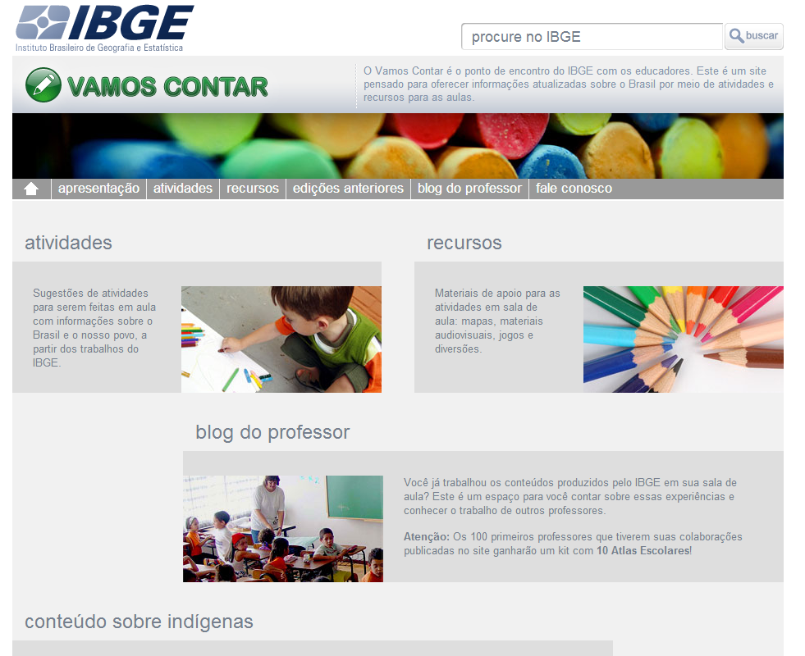
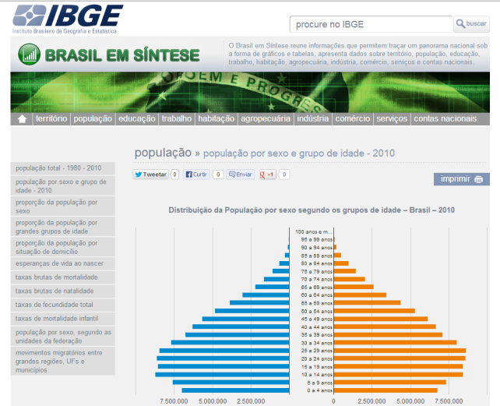
Public segmentation (thematic apps)
Notes:
3

Slide 4
Mashup
Lightweight solutions
Constant updating
User-centric
Smooth and gradual navigation
Visualization tools
Notes:
4

Slide 5
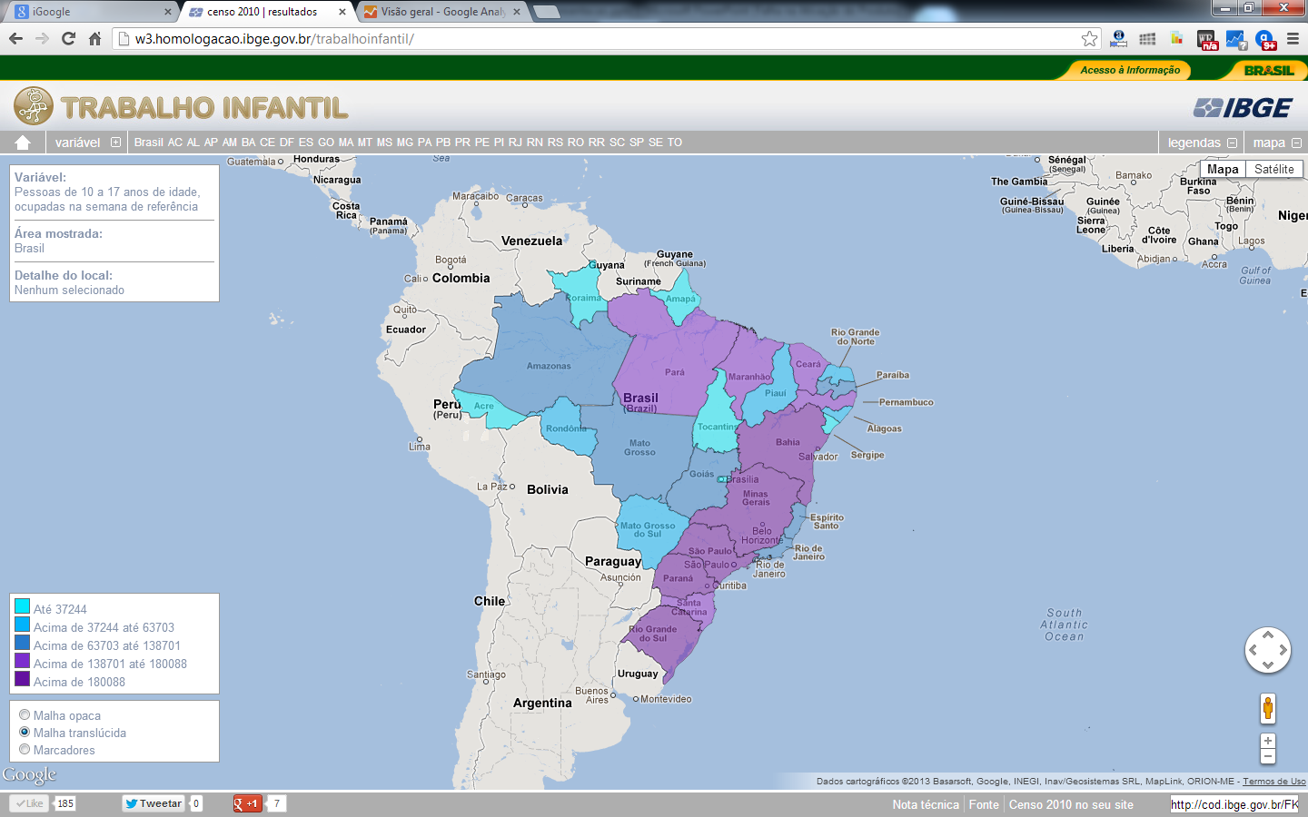
Mashup example

Slide 6
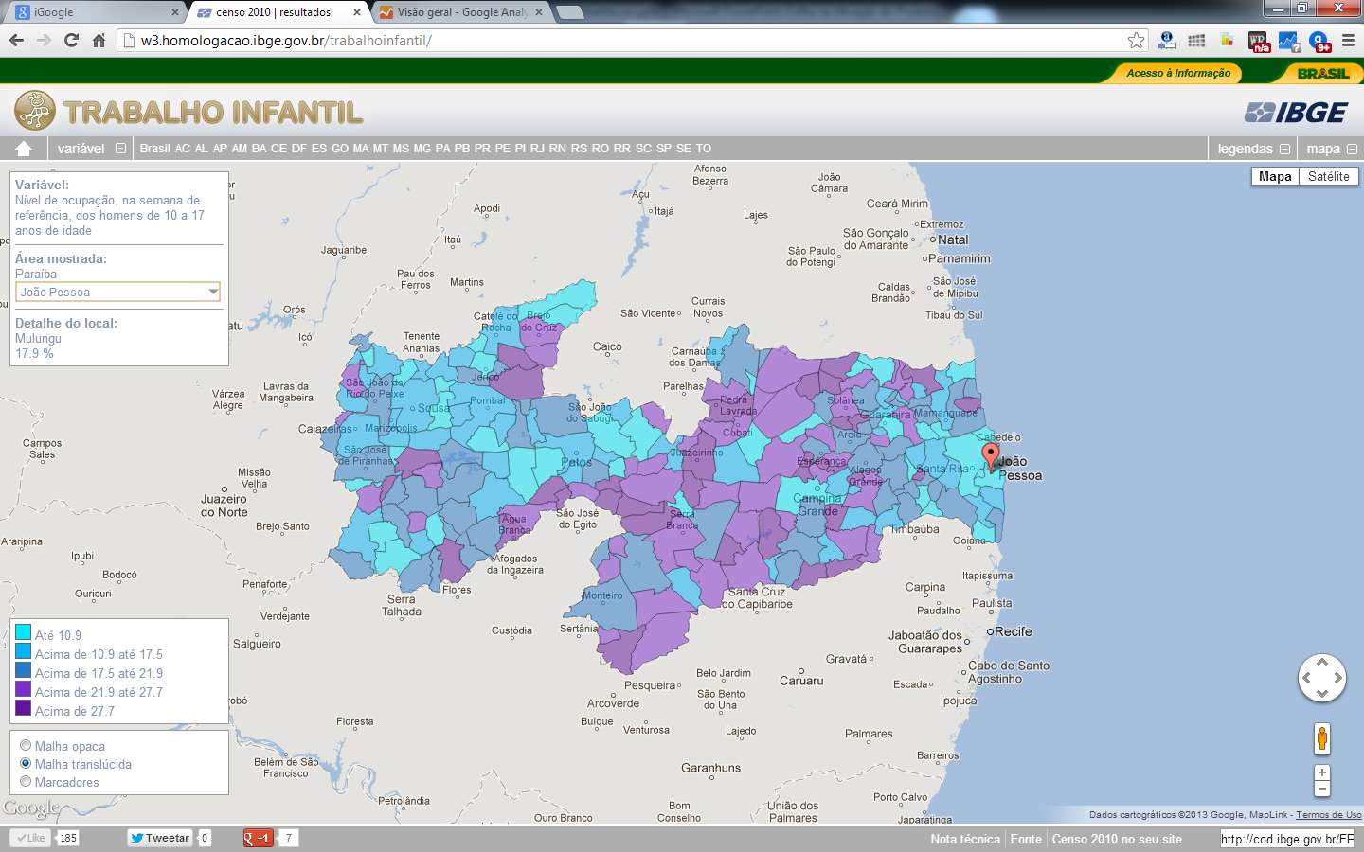
Mashup example

Slide 7
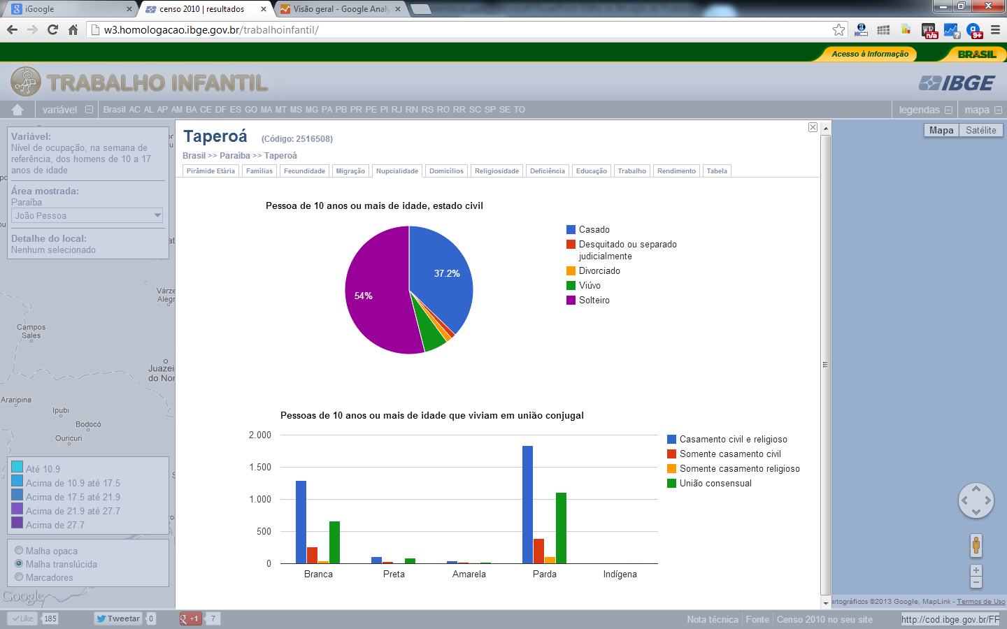
Mashup example

Slide 8
Responsive design
CSS 3
HTML 5
Javascript
Lightweight and multiplatform solutions
User-centric
Notes:
8

Slide 9
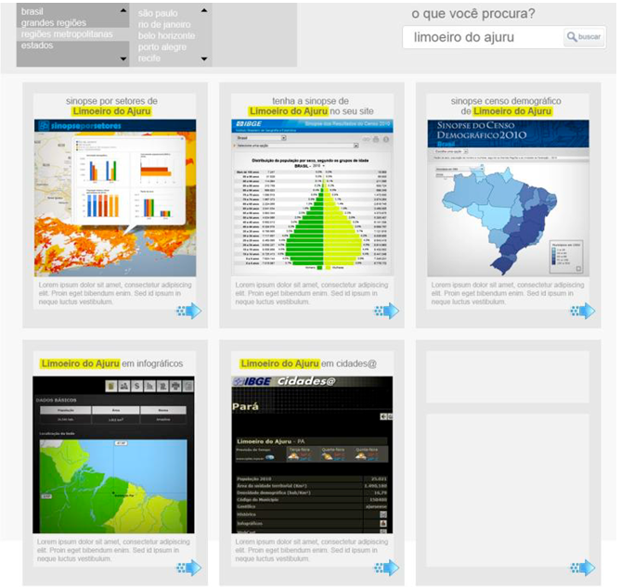
Contextual search (in progress)
Integration of all sorts of information
A simple web architecture
Reduced navigation depth
Multilanguage
Thematic apps
Promptness
Notes:
9

Slide 10
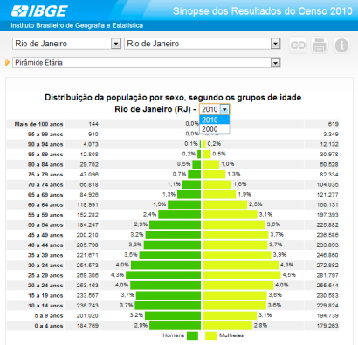
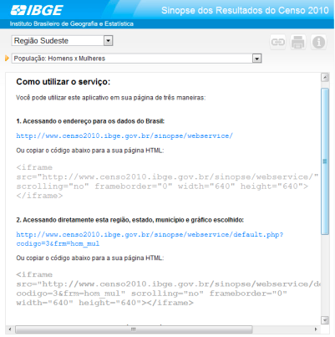
Embeddable services (widgets)
Notes:
10

Slide 11
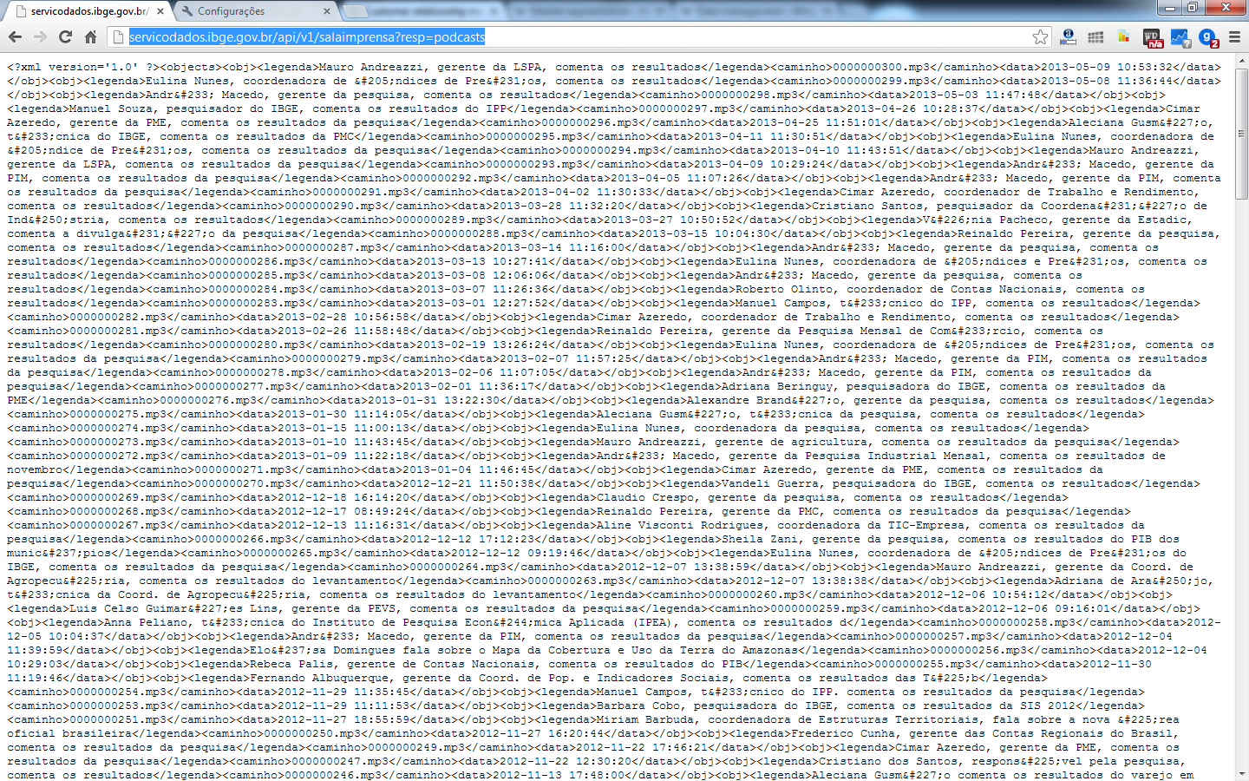
Data services (JSON - SDMX)

Slide 12
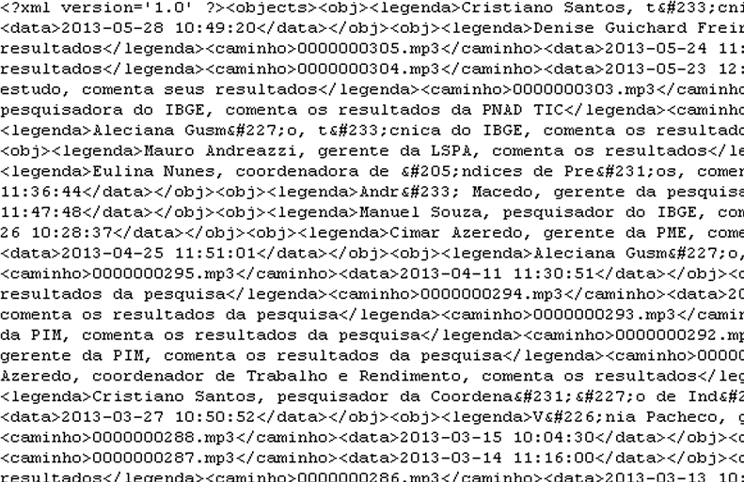
Data services (JSON - SDMX)

Slide 13
Our job is turning data into information.
Information that will create knowledge.
www.ibge.gov.br
ian.nunes@ibge.gov.br
Notes:
13
Slide 34
“Nosso trabalho é transformar dados em informação.
Informação que vai gerar conhecimento.”

